Slide 1



COVID-19
FACE MASK DETECTION

Slide 2
TEAM MEMBERS
2010030168 – Tahseen Begum (Team Leader)
2010030165 – Syed Reshma Banu
2010030234 – Bikkasani Kavya Mani Gayathri
2010030549 – Grishma Neha Chowdary

Slide 3
INTRODUCTION
Before getting started, let us understand the problem better. We want to build a system that can detect faces in real-world videos and identify if the detected faces are wearing masks or not. So, what do we mean by real-world videos?
If you look at the people in videos captured by CCTV cameras, you can see that the faces are small, blurry, and low resolution. People are not looking straight to the camera, and the face angles vary from time to time. These real-world videos are entirely different from the videos captured by webcams or selfie cameras, making the face mask detection problem much more difficult in practice.
In this blog post, we will first explore mask/ no mask classification in webcam videos, and next, shift to the mask/ no mask classification problem in real-world videos as our final goal. Our reported model can detect faces and classify masked faces from unmasked ones in webcam videos as well as real-world videos where the faces are small and blurry and people are wearing masks in different shapes and colors. We will explain more details about the face detector in the next part.

Slide 4
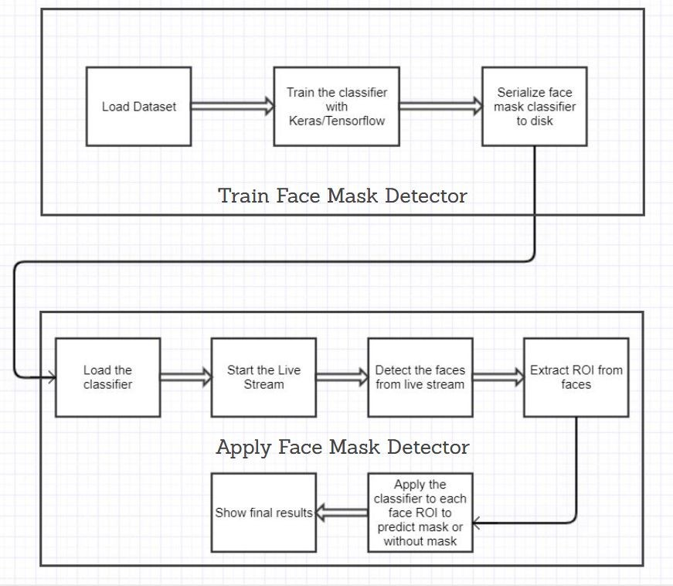

Slide 5
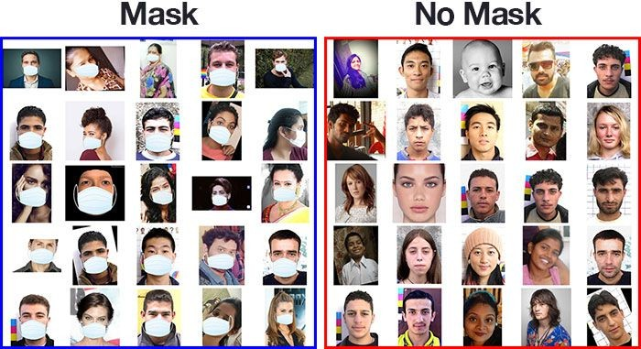
Data Set

Slide 6




How the dataset was created
Techniques used to create images:
Taking normal images of faces
Creating a custom CV script to add face masks to them.
Usually we infer the location of facial structures such as: Eyes, nose, eyebrows, mouth, jawline, teeth, moustache etc.
Steps:
Start with an image of person without mask
Apply face detection to compute the bounding box location of face.
Extract face Region of Interest (ROI)
Get image of a mask, and align it on top of the face properly.
Repeat the steps for multiple images

Slide 7
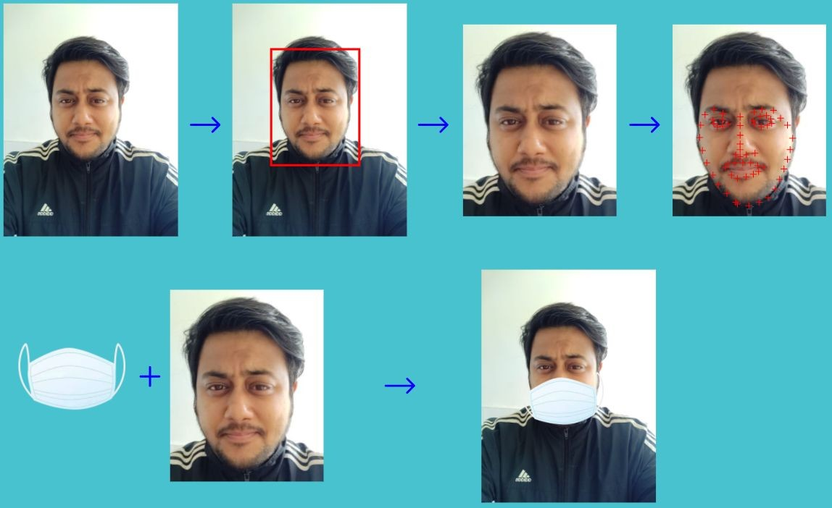
Illustration of the steps performed

Slide 8
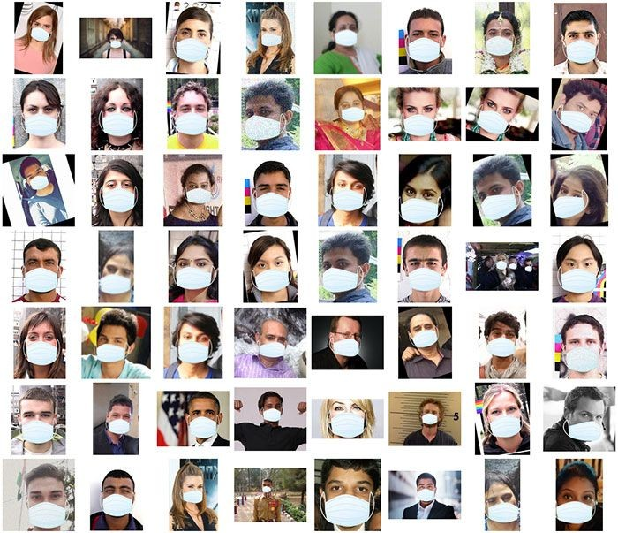
Artificial Face Mask Dataset

Slide 9

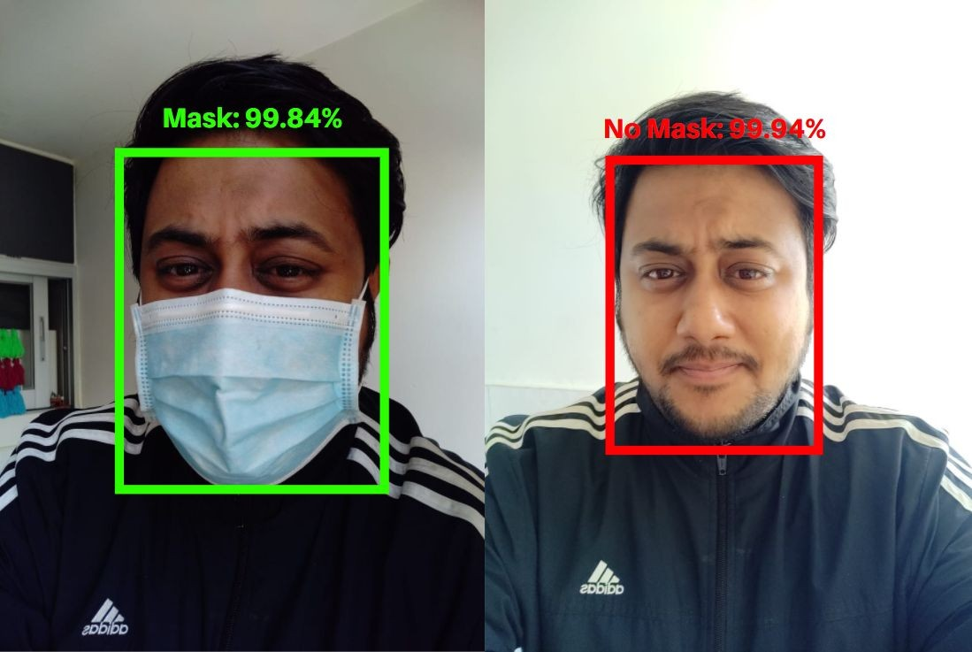




Model Output

Slide 10
Conclusion
Due to the urgency of controlling COVID-19, the application value and importance of real-time mask and social distancing detection are increasing. This work reviewed, firstly, many research works that seek to surround COVID-19 outbreak. Then, it clarified the basic concepts of deep CNN models. After that, this paper reproduced the training and testing of the most used deep pretrained-based CNN models (DenseNet, InceptionV3, MobileNet, MobileNetV2, ResNet-50, VGG-16, and VGG-19) on the face mask dataset. Finally and after evaluated the numerical results, best models are tested on an embedded vision system consisted of Raspberry Pi board and webcam where efficient real-time deep learning-based techniques are implemented with a social distancing task to automate the process of detecting masked faces and violated or maintained distance between peoples.
This embedded vision-based application can be used in any working environment such as public place, station, corporate environment, streets, shopping malls, and examination centres, where accuracy and precision are highly desired to serve the purpose. It can be used in smart city innovation, and it would boost up the development process in many developing countries. Our framework presents a chance to be more ready for the next crisis or to evaluate the effects of huge scope social change in respecting sanitary protection rules.

Slide 11
Future Enhancement
We will exploit this methodology on smart sensors or connected RP nodes that will be considered as an Edge Cloud to collect multimedia data, e.g., an autonomous drone system, which can provide capture (by the camera) of the detected objects from different angles and send them to the Edge Cloud system to be analyzed.

Slide 12



Thanks!
8

